Slide 1

Final Project
Enefit
CSCI E-103
Data Engineering for Analytics to Solve Business Challenges
Final Project Group 6
Adam Brzozowski, Gordon Hew, Noura Almansoori, Brandon Hong, Sam Ippisch, Stefan Mcneil

Slide 2
Introduction
For our final project in CSCI E-103, we chose to work with the Enefit dataset
Enefit is a Baltic region energy utility that started off serving just the national energy market for Estonia , but the firm has branched into neighboring regions and now manages a sprawling portfolio of products spanning natural gas, electricity, and onsite behind the meter green power generation for consumers and businesses
The primary challenge that Enefit has now is that the adoption of clean power has caused volatility in consumption forecasts for electricity
Since demand forecasting is a primary responsibility for any utility, Enefit has posted some of its data on Kaggle to see if data scientists can build a predictive model to simplify this task
Coming up to speed on this project, we had to learn a bit about the energy markets from Adam (who spent over a decade in clean energy) and how the availability of data was driven by market fundamentals
In this deck, we present a robust medallion architecture that simultaneously services existing and incoming data ingestion, business intelligence dashboards, a model registry containing our predictive model
Notes:
https://www.energia.ee/en/ettevottest

Slide 3
Data Engineering

Slide 4
Data Overview
19 files, 1.1 gb
Key tables we used for our silver and gold layer modeling:
Client - reference data about the onsite power location
Train - contains the outcome of how energy is used
Electricity Prices - the cost of electricity in euros / mWh
Gas Prices - the equivalent cost of natural gas in euros / mWh
We decided not to use the weather files because the signal from weather should already be contained in the price signals for gas and electricity and markets are settled before the date the weather conditions occur (weather forecasts are also not reliable)
Joins were explored and undertaken using PySpark and SQL for consistency with the rest of the stack and to design with the intention that this entire application could be productionalized for much larger scale data than the sample given to Kaggle

Slide 5
Key Energy Industry Variables
The target dependent variable for the entire study is the amount of energy produced or consumed (train_csv.is_consumption) by a given site on a given day (train_csv.target)
The size of the energy system at each site - in kilowatts (kW) - measures the installed capacity to generate power for a given site (client_temp.installed_capacity)
The time of day and date (train_csv.datetime) drives solar production (peak production summer solstice, noon) due to the earth’s rotation around the sun
Data_block_id prevents information leakage based on when data is actually available for use in forecasting and goes back to the workings of the energy futures market
The relative price of natural gas MWh equivalent (gas_prices.highest_price_per_mwh) vs electricity (electricity_prices.euros_per_mwh) vis a vis exports to the grid of power directly measures relative market efficiency
Notes:
https://www.weather.gov/dvn/Climate_Astronomical_Seasons

Slide 6
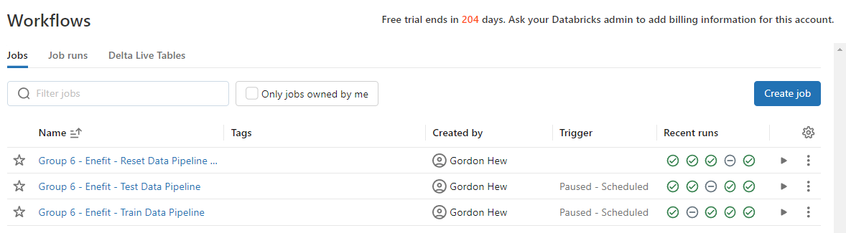
Data Pipeline - Workflows
Figure 1: Enefit Data Pipeline Workflows
Reset Data Pipeline | Truncates tables Removes checkpoints
Train Data Pipeline | ETL Enefit CSV training/test data in a simulated “daily-block” fashion into bronze, silver, and gold tables
Test Data Pipeline
Notes:
Hi, I’m Gordon Hew and I’ll be going over how we orchestrate our data engineering pipelines
We use Databricks Workflows to manage our pipelines.Currently, the pipelines are manually triggered. However, we can configure them on a schedule or run them continuously depending on the velocity of the data.
Our environment consists of three workflows, the first workflow is a job consisting of a single task that resets our environment by truncating tables and removing checkpoints.
The next two jobs are our train and test pipelines that we use to ingest and process data.
These two pipelines use the same underlying code with job parameters adjusted to specify where to read data and which schema to write it to

Slide 7
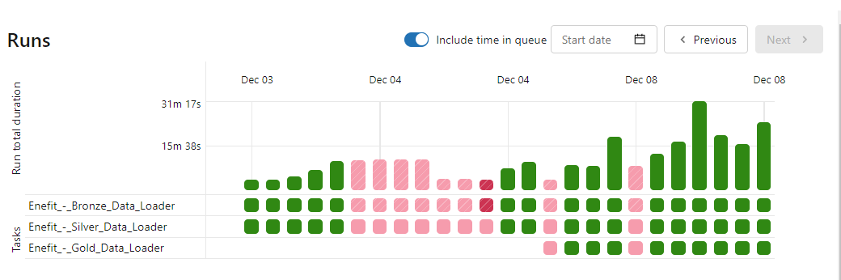
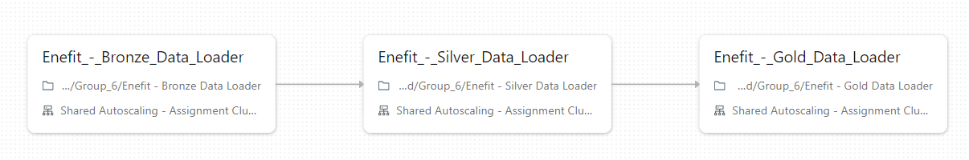
Data Pipeline - Jobs - Daily-Block Refreshes
Figure 2: Enefit Data Loader Tasks and Runs
🥉Bronze Data Loader | 🥈Silver Data Loader | 🥇Gold Data Loader
Loads CSV raw data into bronze tables using Spark batch processing Includes configuration for “daily-block” refresh simulation 1-to-1 table to CSV association Includes file and job metadata information with each row entry | Reads data from Bronze tables and takes the latest data and stores into a silver table using Spark batch processing Cleans raw data retrieved from the bronze layer before persisting | Creates aggregate views of data for BI dashboard by performing merge, upserts using Spark batch processing Imports training data for use by ML applications using Spark Structured Streaming (trigger-once)
Train and Test Pipelines use the same underlying code but run with different job parameters Jobs are currently run manually but we can easily schedule the job to run continuously or at a fixed interval Job is configured as a queue with a maximum concurrency of 1 to avoid possible data consistency issues
Notes:
Digging deeper into our workflows, we review the test/train jobs which consists of three tasks depicted in screenshot on the top-left. Meanwhile, the screenshot on the right depicts the multiple runs that we’ve done during our development and testing.
The bronze data loader loads n-number of data blocks from the raw CSV files to simulate daily runs. So if you run this pipeline again, it’ll consume the next n-number of data blocks.which allows us to verify our support for daily refreshes
Using Spark, we load raw data and append meta information like job id, file path location, and timestamp to the records which is then stored into our bronze tables
The silver data loader ingests the latest records from the bronze tables, cleans them, and inserts them into our silver tables.
The gold data loader creates aggregate views that are merged and upserted into our gold tables. It also streams in silver training data configured with “trigger-once” into its associated gold table using Spark Structured Streaming..
Also, we configure our pipeline as a queue with a concurrency of 1 to to avoid possible data consistency issues

Slide 8








Buildup to Gold Layer
+
Bronze
Silver
Gold
Business Intelligence
Databricks Dashboards
Enefit Raw Data
+
Historical Gas Prices
Historical Electricity Prices
Historical Weather Forecasts
Clients
Training Data
Test Data
Historical Gas Prices
Historical Electricity Prices
Historical Weather Forecasts
Clients
Training Data
Test Data
Historical Gas Prices
Historical Electricity Prices
Historical Weather Forecasts
Clients
Training Data
Test Data
Flattened Feature View
Aggregated - Merged and Upserted
Historical Energy Prices
Historical Production / Consumption
Streaming
Training Data
Test Data
Data Science / ML
Pyspark ML
MLflow
Notes:
This diagram provides a high level overview of our data engineering infrastructure where we are using Databricks as our data platform which sits on top of AWS for compute and shows where we use Spark and Spark Structured Streaming.
Our pipelines consumes raw data and pushes it through through the medallion layers by storing the data in our delta lake. Our BI Dashboard and ML processes then consume this data.

Slide 9
Data Science
Notes:
Nice thanks Gordon, so i’ll be taking the next slides, so Adam if you want to go to the next slide for me please, we can get right into the problem statement that the data science portion is trying to solve.

Slide 10
Define the problem
Multivariate time series analysis
Target variable: Consumption/Production Amount
Day ahead markets, data is available in data block IDs
Large scale compute necessary…
Categorical Features Available:
county - Different ID for each County
is_business - Boolean for if consumer a business
product_type - Category for one of four contract types
Is_consumption - Boolean for if target is consumption or production
Notes:
The main point of this slide is to specify what problem we were trying to solve, and that problem is that we wanted a model to predict the amount of future energy consumption and production amounts that the Enefit company would be responsible for in the future. This prediction would be predicted by using data released by the energy company in chunks of data, which they called data blocks, and each block had a specific block id. We’ll talk more about the block ids in the next slide for our approach to creating the model, but the main point i wanted to get across in this slide was that our main goal was to get a model that is able to predict future energy amounts that the company would be responsible for.

Slide 11
Approach
Read data from Silver layer on the 5 most recent blocks and train the model
Gradient-Boosted Regression Tree
Ensemble of weak prediction models with little assumptions about the data
Root Mean Square Error (RMSE) as a Performance Evaluator through Cross Validation
Select best model where RMSE is minimized
Log model through MLFlow

Slide 12
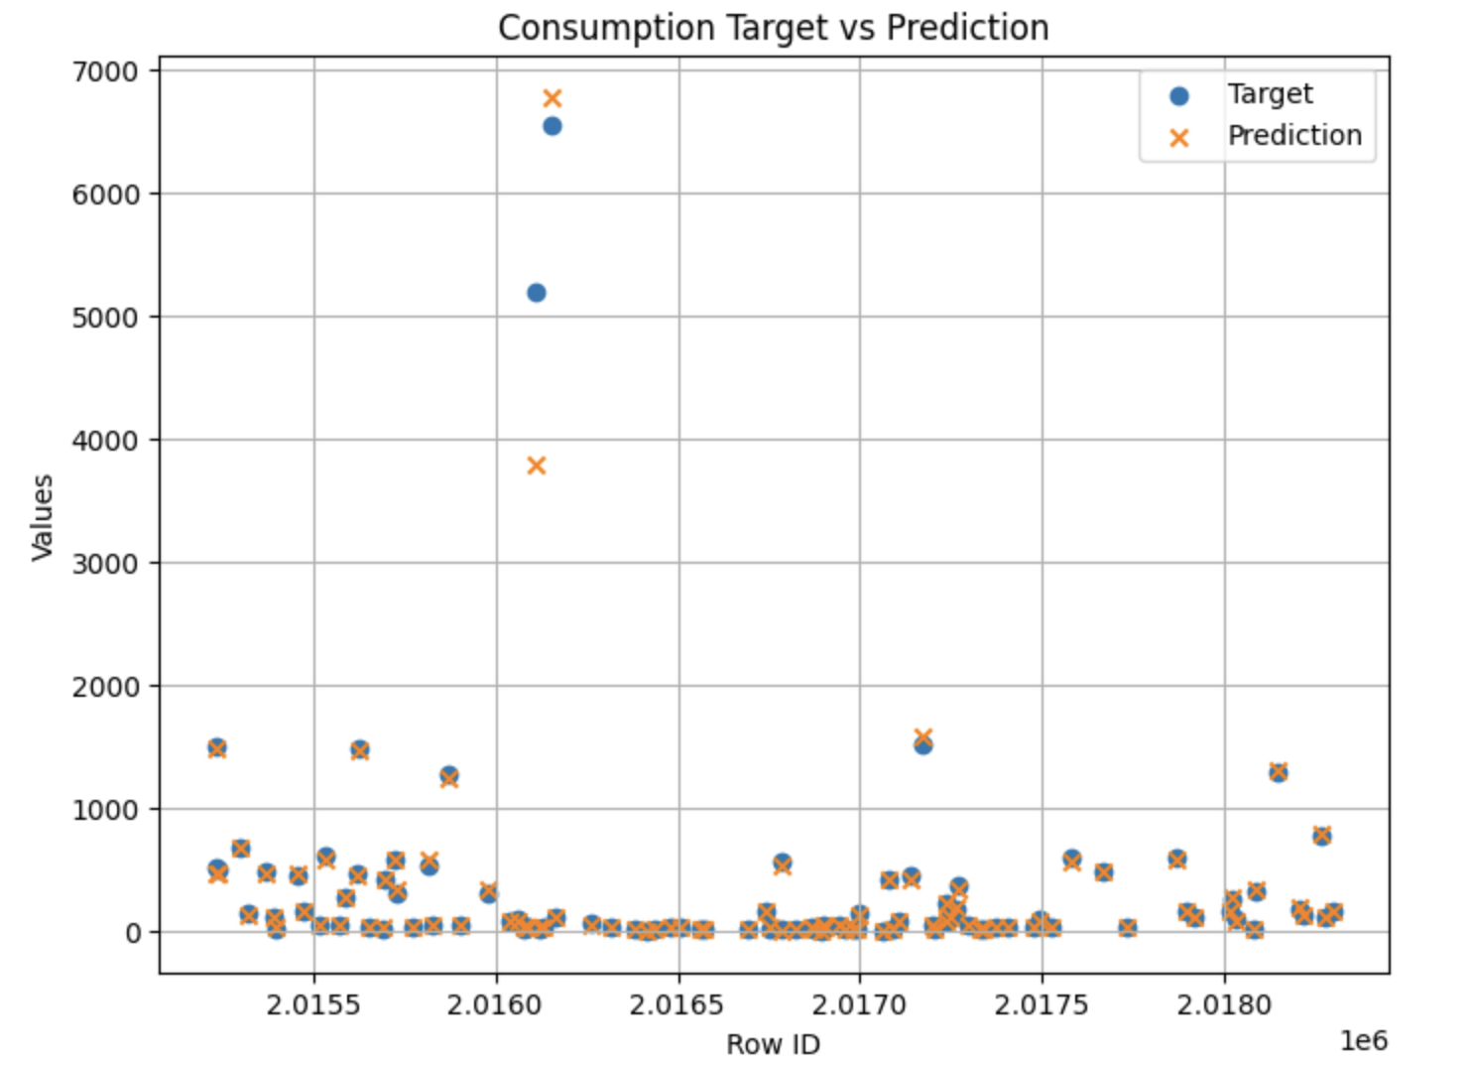
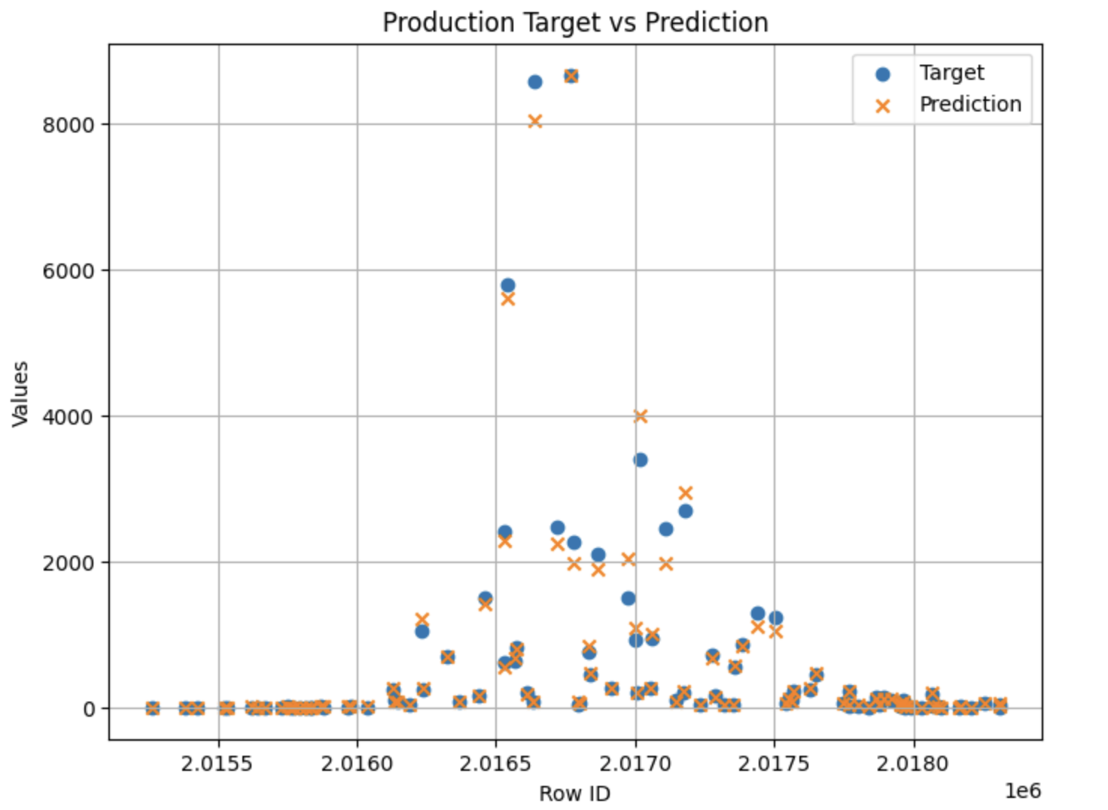
Model Performance
Evaluation is on the test part of the training dataset
Performance: <3% RMSE
Notes:
And after building this model, we of course wanted to see how we did and we did that through evaluating the performance with the test part of the training dataset. You can see here, our performance actually, (surprisingly), did quite decently well, with our model able to accurately predict many of the values on the lower target range, and also some of the higher ranged outlier values as well, however of course the model gets a bit flakey on the higher range outliers, which of course is expected, but the predictions on the outliers are still in the same ballpark. We used a couple different metrics to quantify the performance of the model, and we report on the percent root mean squared error here, which is basically the root mean squared error metric, normalized by the range of target values. From all our runs, our model has been able to produce a percent root mean squared error that is less than 3%. And now Adam if you’d like to hit the next slide please, this will be where Sam is taking over

Slide 13
Make Predictions
We used mlflow server on Databricks to store our model
Daily job is scheduled to refresh the model with newer training data and log predictions
Model pipeline serves predictions about what’s going to happen
Historical vs actual results presented on dashboard

Slide 14
Future Model Enhancements
Create separate models for Production or Consumption targets
May have different behavior
Increase number of hyperparameter settings
Limited to improve model efficiency
Increase number of data blocks used in training data
Limited size of train dataset for model efficiency
Feature engineering to capture effects of relationships between features
Does the ‘Combined’ contract type have a greater impact on Business vs. Commercial consumers?

Slide 15
Business Intelligence

Slide 16
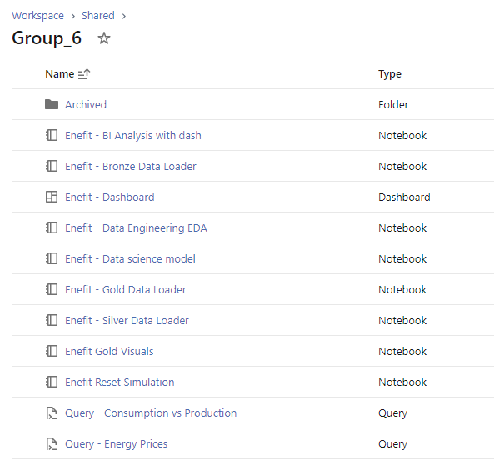
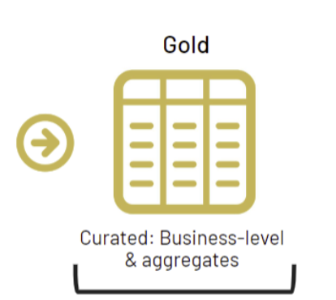
Queries to Populate Dashboard

Slide 17
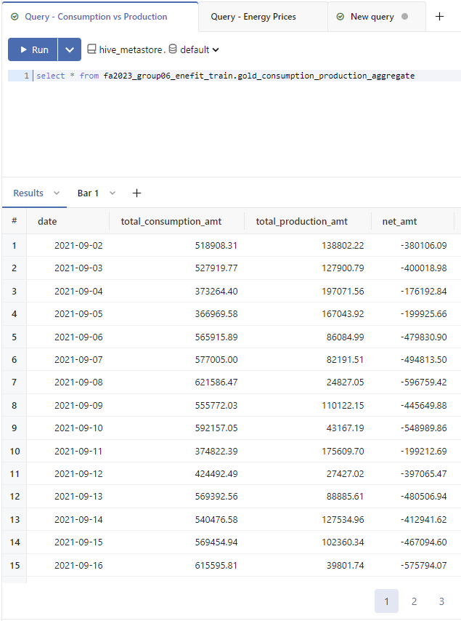
Queries to Populate Dashboard

Slide 18
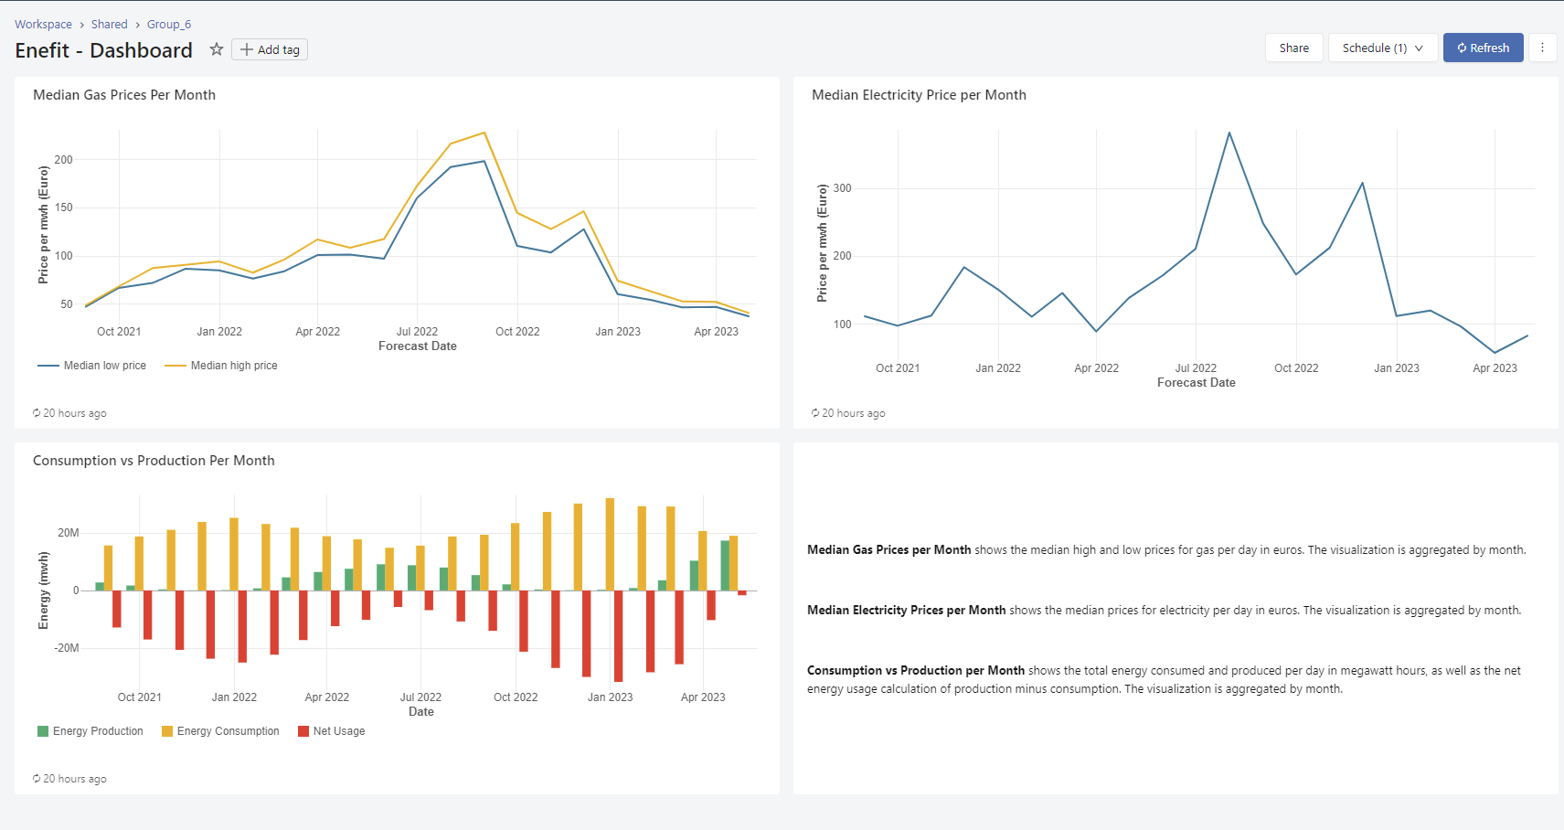
Enefit - Dashboard

Slide 19
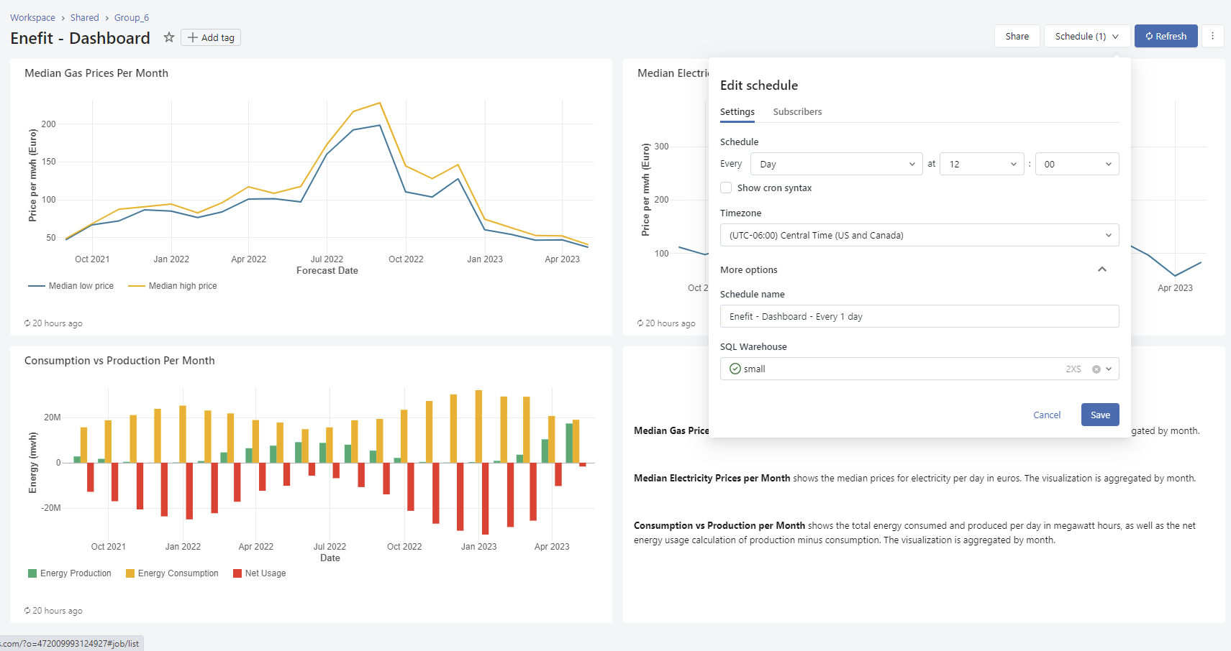
Refresh Dashboard Daily

Slide 20
Relevant Visualizations of Insights

Slide 21
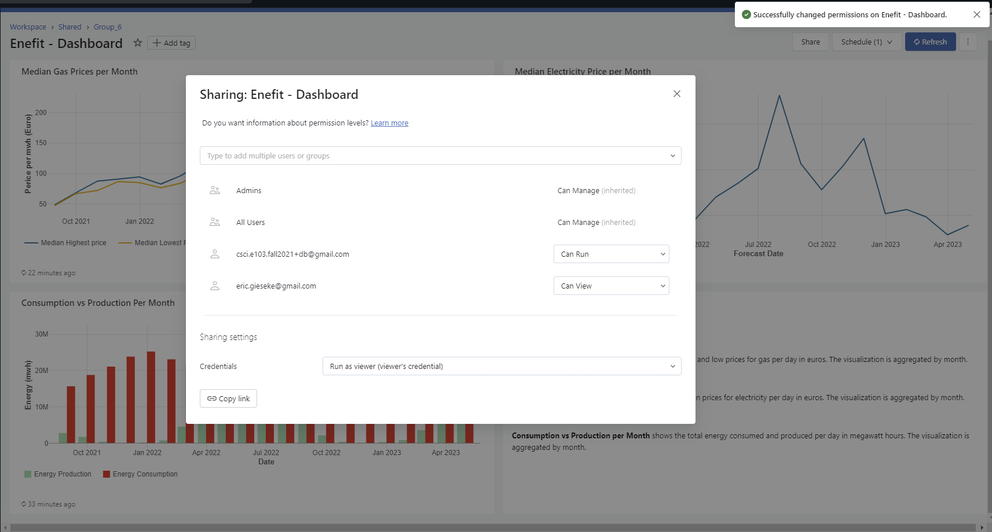
Security Model
Security Model shows different permissions for different users.
Default privileges for Admins and All Users were kept to ensure team could access dashboards.
Selective access was given to our professors for proof of concept.

Slide 22
Data Architect

Slide 23
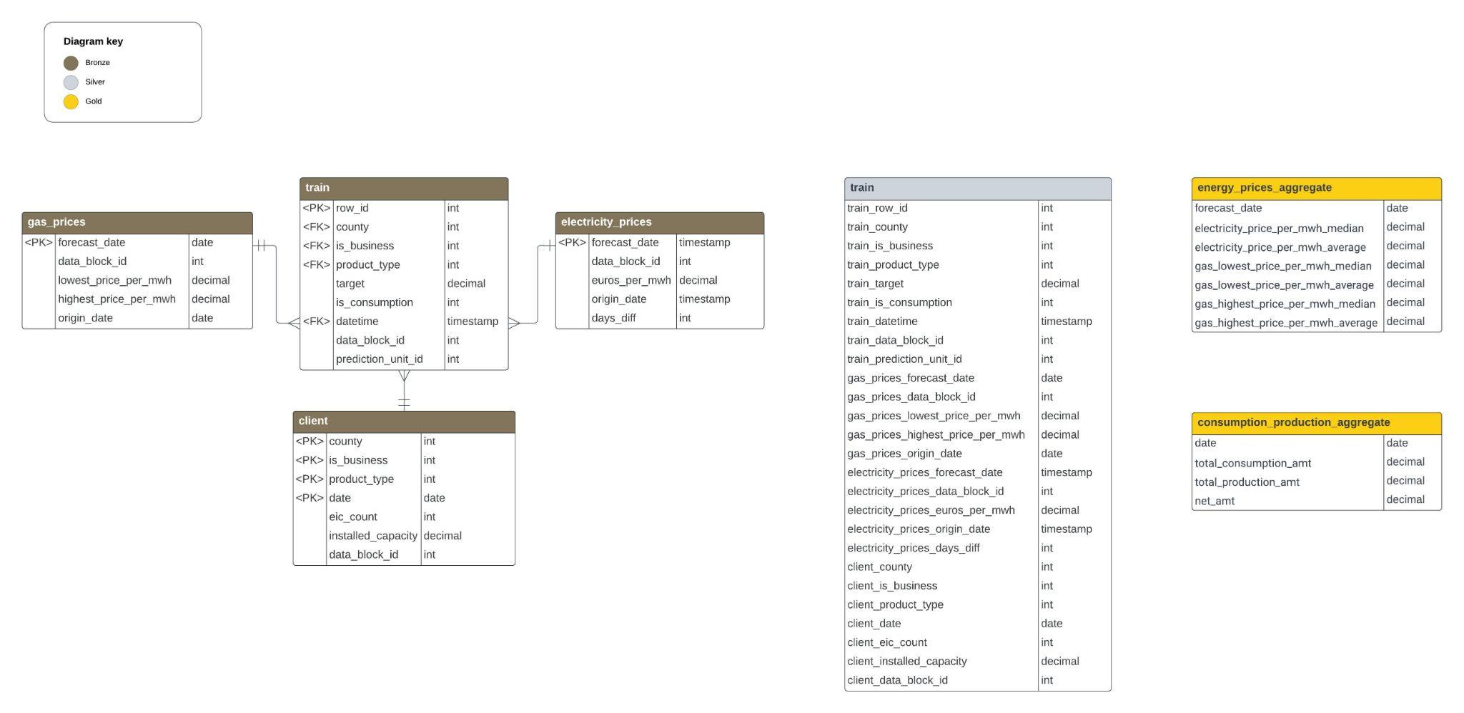
Entity Relationship Diagrams

Slide 24
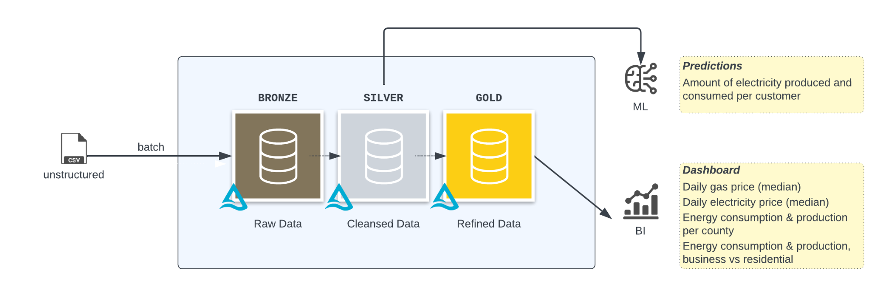
Data Flow Diagram

Slide 25
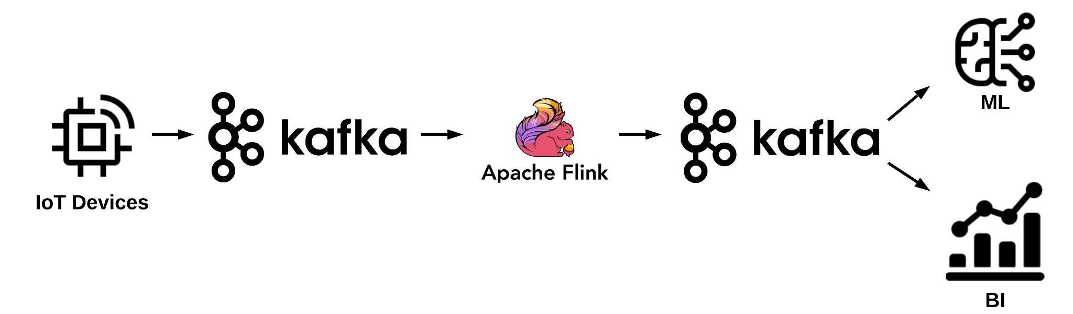
Streaming Solution
Data Ingestion: Kafka acts as a buffer for ingesting real-time energy consumption and production data.
Stream Processing: Leverage Apache Flink for complex stream processing tasks based on actual event times.
Scalability: Both Kafka and Flink are designed for horizontal scalability.
Fault Tolerance: Kafka ensures fault-tolerant data transportation, while Flink provides fault tolerance for stateful stream processing.
Integration: Kafka serves as a reliable source and sink for Flink jobs.
Notes:
IoT - smart grid

Slide 26
Table Partitions
Option 1: Block ID
Option 2: Date
Option 3: County
Data arrives in blocks
Blocks correspond what’s available at the time
Organize partition based on date values regardless of what was available
Time based retrieval
Organize based on geographic indicators
More efficient for data and analysis related to those regions

Slide 27
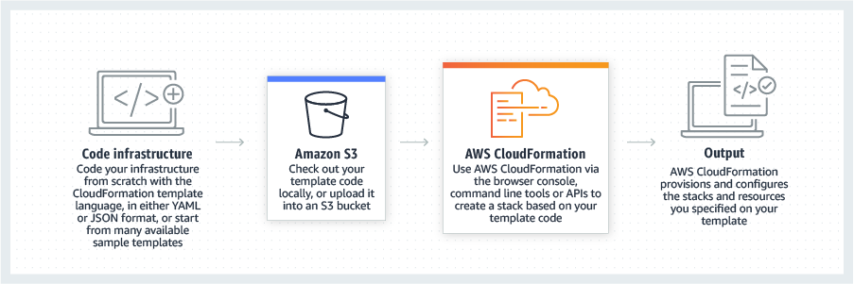
CI/CD and Disaster Recovery
AWS CloudFormation
Disaster Recovery Using Infrastructure as Code (IaC)
Scale infrastructure worldwide
Repeatable deployments
Backup critical data to separate storage
Continuous Integration:
Developers continuously make changes to code
Version controlled repository
Consistent way to validate changes
Continuous Deployment:
Automated deployment process and testing
Rollback
https://aws.amazon.com/cloudformation/

Slide 28
Conclusion

Slide 29
Enefit Pattern Recap
The medallion architecture demonstrated for the Enefit business case is highly generalizable and robust
With a single approach, we address daily data ETL, machine learning, and business intelligence use cases
By using Spark, we are able to leverage the full richness of the multivariate time series available for this problem without memory constraints
With mlflow as our model registry, we enable machine learning operations to provide for an orderly promotion of new models to the production environment as well as prediction serving
Our single data pipeline also enables centralized data governance for all data products

Slide 30
Q&A

